Slide 1

Spring boot security

Slide 2
Student Role
getStudent()

Slide 3

Admin Role
getAllStudents()
registerNewStudents()
deleteStudent()
updateStudent()

Slide 4

Admin Trainee Role
getAllStudents()

Slide 5
Types of Authentication
Role Base Authentication
Permission Base Authentication
Method Base Authentication with Annotation

Slide 6
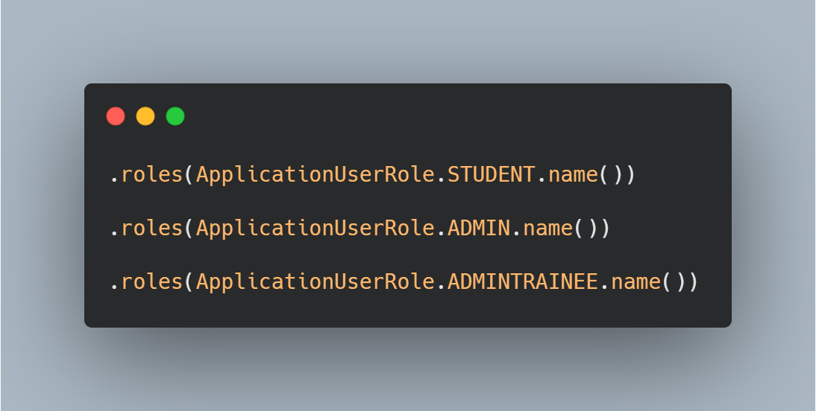
Role Base Authentication

Slide 7
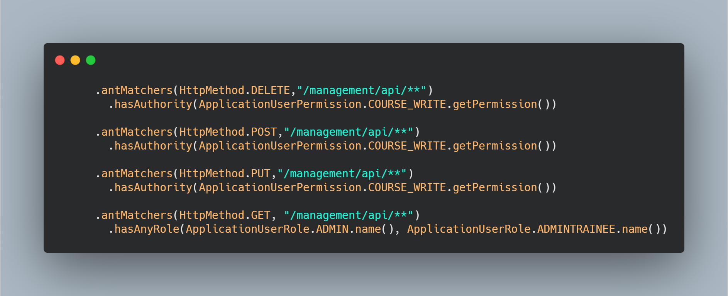
Permission Base Authentication

Slide 8
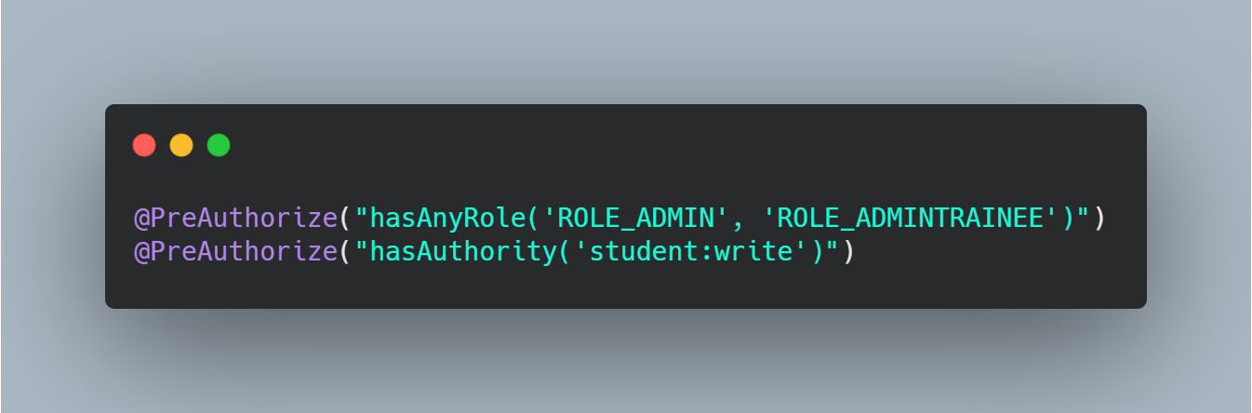
Method Base Authentication

